Slide 1

TOOLS IN PROJECT MANAGEMENT
Institut supérieur d'informatique
Course: IT Project Management Tools & Techniques Professor: Christelle Faivre
Group 3:
Simranjit
Palak
Manan

Slide 2
Existing Development Process
Software development had little documentation.
Solutions were communicated via email. There was no formal process for technical write-ups, process documentation or status updates.
Software deployments, issues and incidents were communicated verbally or by email.
Procedural documentation was decentralized across the network and difficult to locate in a timely manner.

Slide 3
Current Market Trends
Artificial Intelligence (AI) & Automation
Hybrid Project Management Approaches
Emotional intelligence (EQ)
Increased Organizational Collaboration
Data Analytics & Numbers
Advanced Project Management Tools & Solutions
Increased Remote Working

Slide 4
Project Management Trends
Asana
Project Libra
Monday.com
Trello
Jira

Slide 5
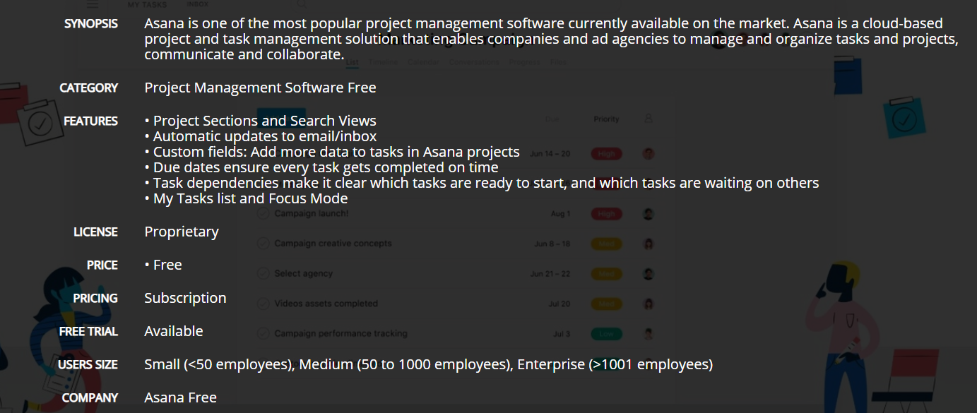
Asana

Slide 6
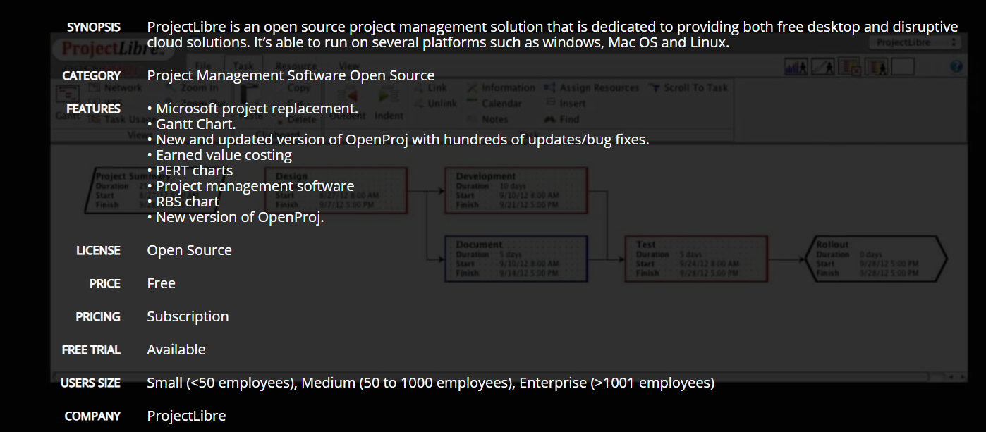
Project Libra

Slide 7
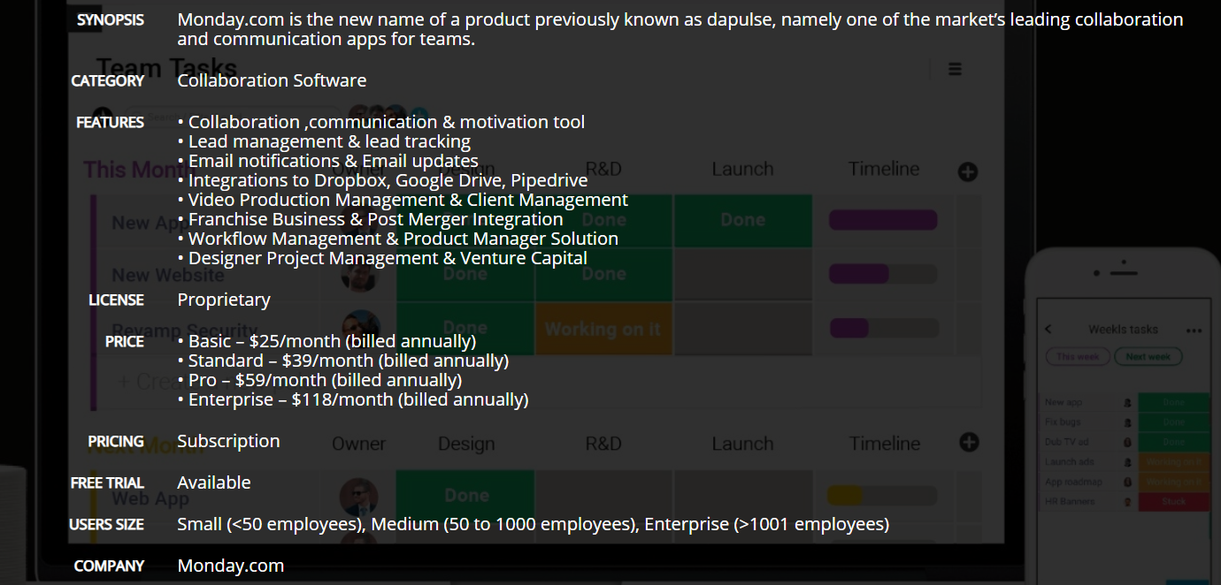
Monday.com

Slide 8
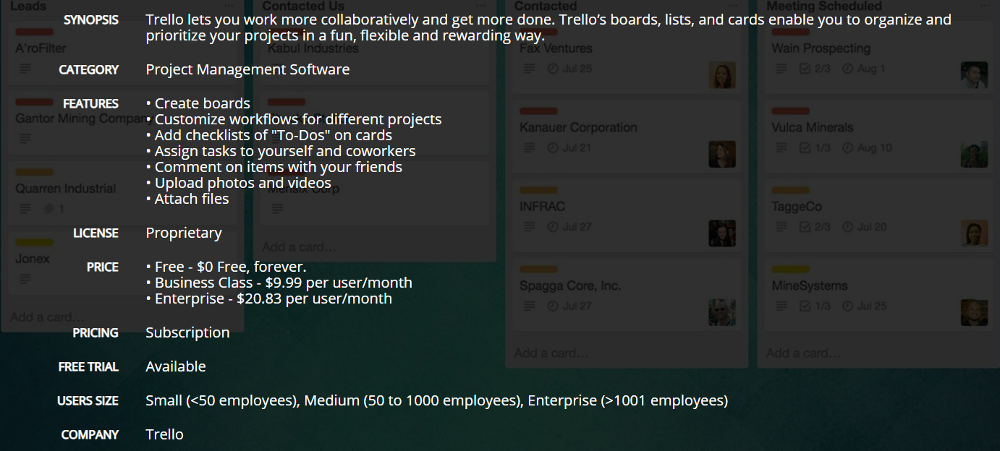
Trello

Slide 9
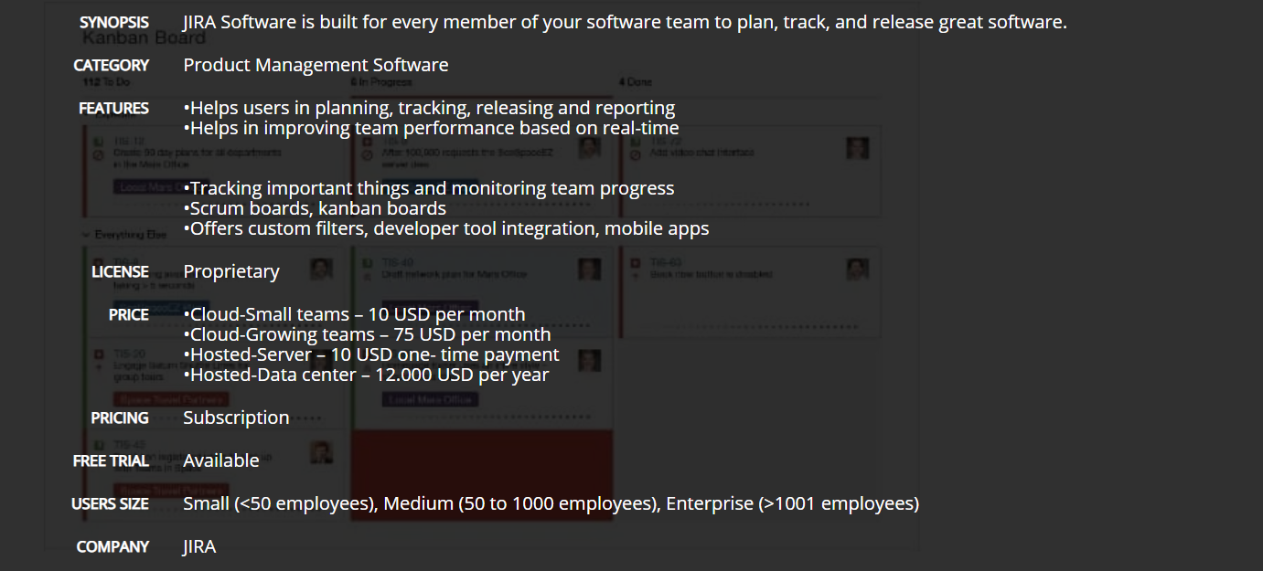
Jira

Slide 10
Selection Criteria
Category
Features
License
Price
Pricing
Free Trial
Users Size

Slide 11
Comparison
Criteria | Asana | Project Libra | Monday.com | Trello | Jira
Price | Free | Free | Basic - $25/month Standard -$39/month Pro - $59/month Enterprise -$118/month | Free - $0 Business Class - $9.99 per user/month Enterprise - $20.83 per user/month | Cloud-Small Teams - $10/month Cloud-Growing Teams - $75/month
Pricing | Subscription | Subscription | Subscription | Subscription | Subscription
Free Trial | Available | Available | Available | Available | Available
User Size | Small (<50) Medium (50 -1000) Enterprise (>1000) | Small (<50) Medium (50 -1000) Enterprise (>1000) | Small (<50) Medium (50 -1000) Enterprise (>1000) | Small (<50) Medium (50 -1000) Enterprise (>1000) | Small (<50) Medium (50 -1000) Enterprise (>1000)
License | Proprietary | Open Source | Proprietary | Proprietary | Proprietary

Slide 12
Recommendation
Free & Open Soure : Asana & Project Libra
Licensed : Monday.com, Trello & Jira
Best Solution : Jira

Slide 13
Jira Cloud Implementation
Step 1 - Create a project for internal stakeholders
Step 2 - Pick a template
Step 3 - Set up your columns
Step 4 - Create an issue
Step 5 - Invite your team
Step 6 - Training for the team members
Step 7 - Move work forward

Slide 14
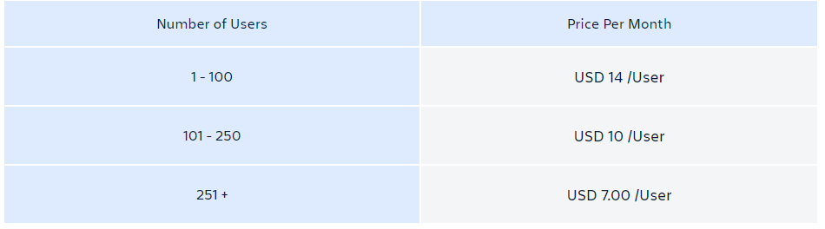
Jira Cloud Subscription Cost
Monthly Pricing :

Slide 15
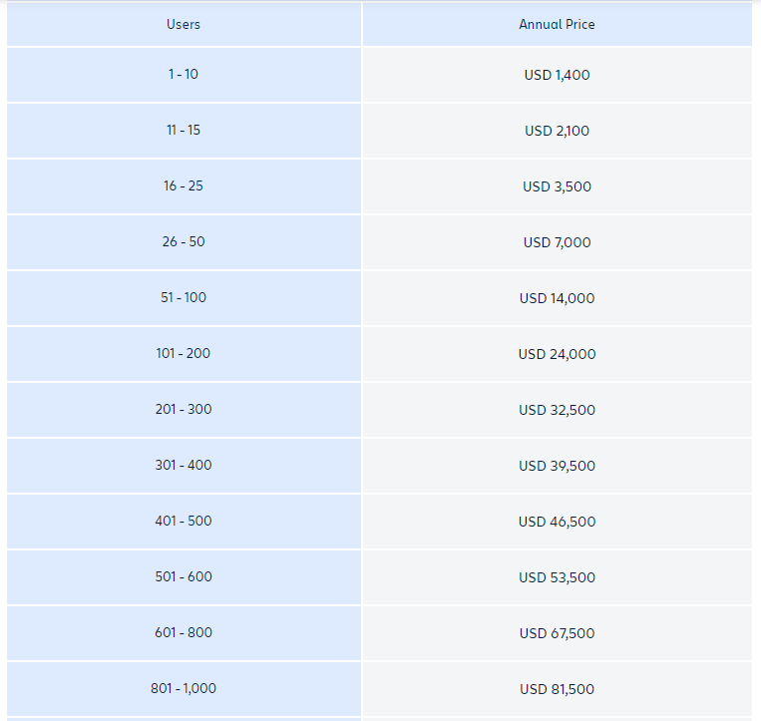
Jira Cloud Subscription Cost
Annual Pricing :

Slide 16
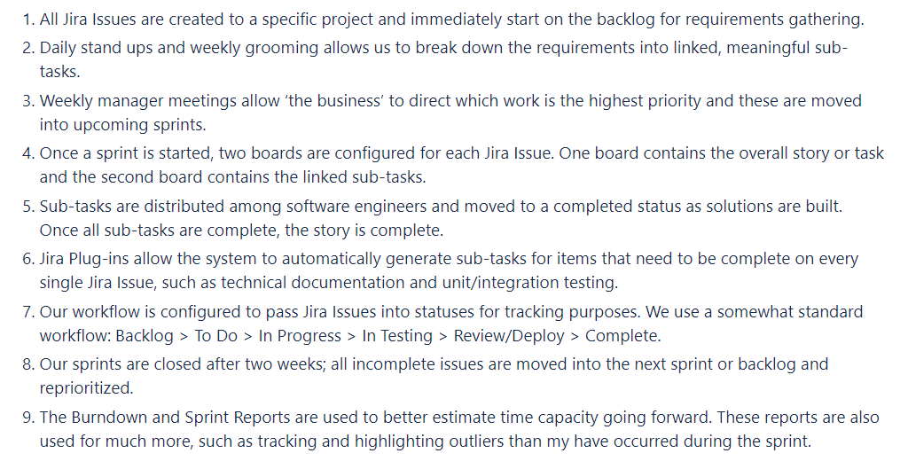
New Development Process

